Slide 1

MCP Servers
Connecting AI to Your Enterprise Data
A business executive's guide to Model Context Protocol and its strategic value for database integration
January 2026

Slide 2
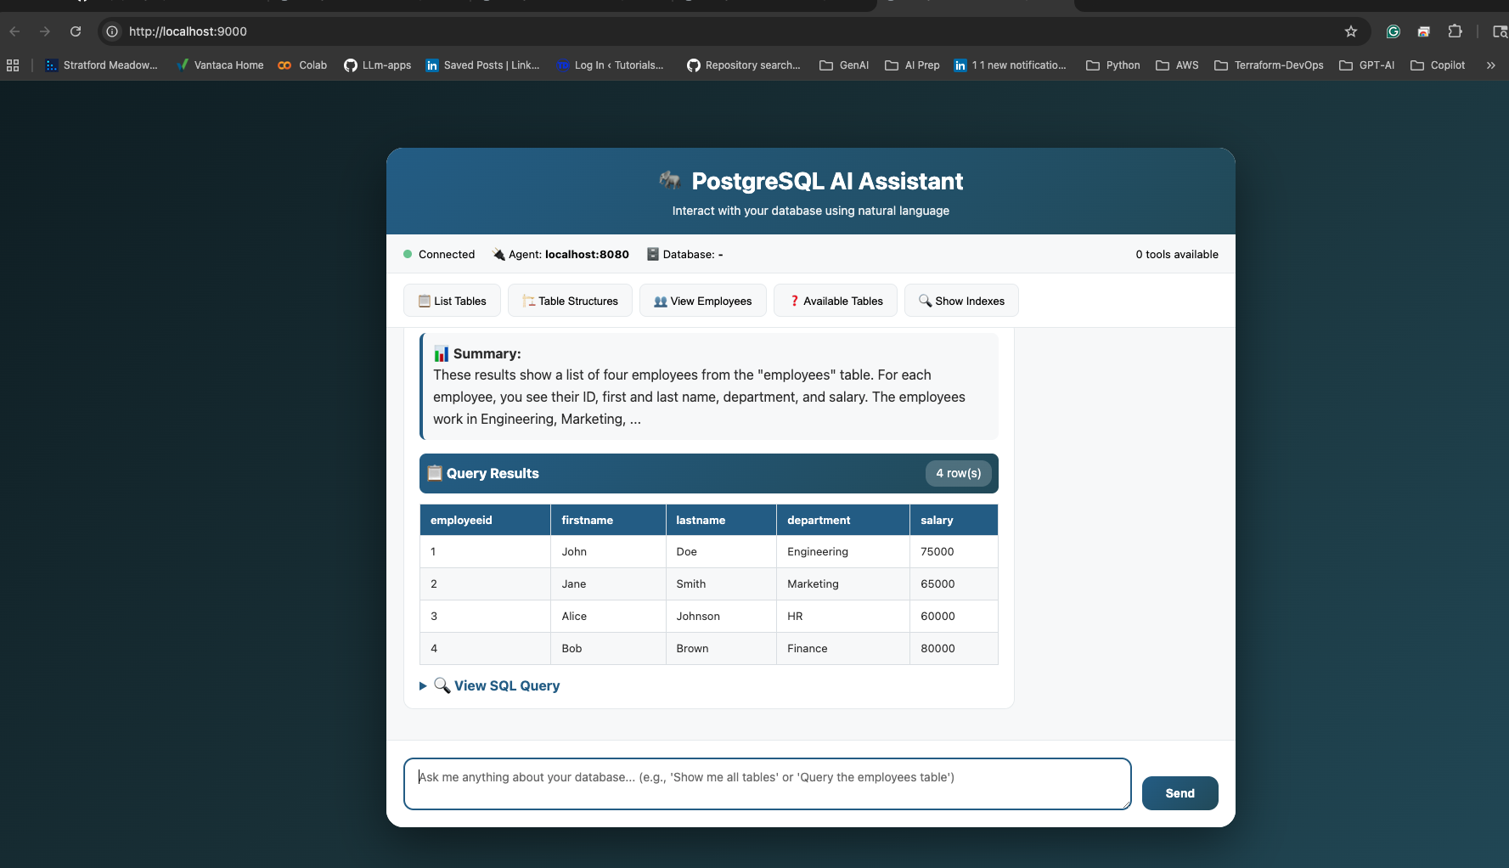


Slide 3
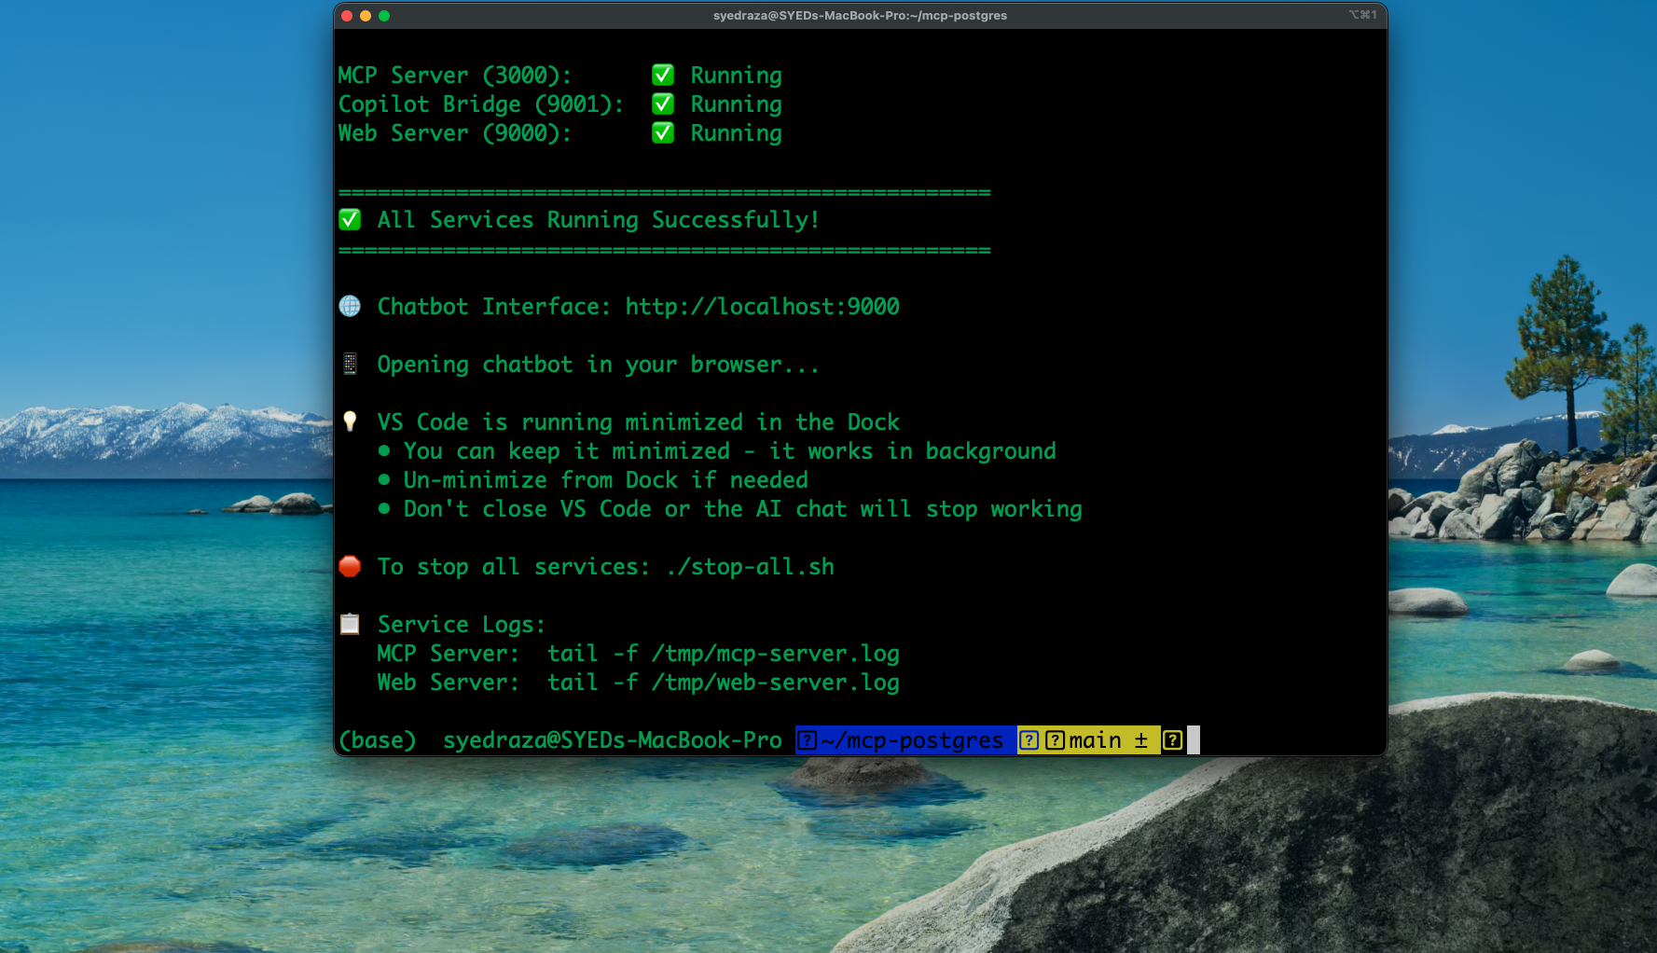

Slide 4
The Problem
Business Impact
Data Silos
40%
Critical business data locked in databases that AI cannot access
of work time spent searching for information
Manual Processes
3hrs
Teams copy-paste data, creating delays and errors
average delay getting answers from data teams
Security Concerns
$$$
No standard way to give AI controlled access
missed opportunities from slow insights
Without proper integration, AI remains disconnected from your most valuable assets

Slide 5

The Solution: Model Context Protocol
What is MCP?
A universal standard that allows AI assistants to securely connect to any data source. Think of it as creating secure bridges between AI and your enterprise systems.
1
2
3
Standardized
Secure
Scalable
One protocol works across PostgreSQL, GitHub, Snyk, and any other platform
Controlled access with proper authentication ensures AI only sees what it should see
Add new data sources without rebuilding your AI infrastructure from scratch
Key Insight: MCP turns your AI from a standalone tool into an integrated member of your technology ecosystem
Model Context Protocol - Anthropic's open standard for AI-data integration

Slide 6
PostgreSQL MCP Server
Business Benefits
What It Does
Faster Decisions
Connects AI assistants directly to your PostgreSQL databases to query and extract insights in real-time.
Executives get real-time insights without technical bottlenecks
Business Use Cases
Cost Reduction
Reduce analyst workload on routine queries by up to 70%
Ask questions in plain English and get instant answers from live data
Generate custom reports without waiting for data analysts
Identify trends and anomalies through natural language queries
Data Democratization
Non-technical teams access insights independently
Speed Impact: Reduces data query time from hours to seconds
Audit Trail
All queries logged for compliance and security
Read-only access ensures data safety while enabling powerful analytics

Slide 7


GitHub and Snyk MCP Servers
GitHub
Snyk
Code Repository Intelligence
Security and Compliance
What It Does
What It Does
AI accesses repositories, pull requests, and issues to understand your codebase
Scans code for vulnerabilities and security risks across your entire stack
Business Value
Business Value
New developers understand codebases 60% faster
Code review automation identifies potential issues
Auto-generate technical documentation
AI alerts on critical vulnerabilities instantly
Catch issues before they reach production
Automated security audit trails
ROI: 15-20 hours saved per developer monthly on code reviews
Risk Mitigation: Average data breach costs $4.45M
Both integrations provide read-only access with full audit logging for security

Slide 8
Implementation Roadmap
PHASE 1
PHASE 2
PHASE 3
Discovery
Pilot
Expansion
Week 1-2
Week 3-6
Week 7-12
Identify data sources
Assess security
Define use cases
Deploy PostgreSQL
10-20 user group
Measure gains
Add GitHub/Snyk
Company-wide rollout
Establish governance
Investment Overview
Setup Time
Critical Success Factors
2-3 weeks
Executive Sponsorship for resources
Security Partnership from day one
User Training for adoption
Metrics Tracking for ROI
per data source
Tech Resources
1-2 FTE
for implementation
Break-Even
3-6 months
typical ROI
Start small, prove value, then scale across the organization

Slide 9

Next Steps
Why MCP Matters for Your Business
Ready to Get Started?
Transform Decision Speed
Immediate Actions
From hours of waiting to seconds of insight - MCP eliminates data access bottlenecks
Schedule discovery workshop with IT and Security
Identify 3-5 high-value use cases
Select pilot team (10-20 users)
Establish success metrics
Secure and Compliant
Enterprise-grade security with full audit trails and controlled access permissions
Expected ROI Timeline
Future-Proof Investment
3-6
Open standard that works with any AI platform and scales with your needs
months to positive ROI
Questions? Contact your AI transformation team to explore MCP integration

